Slide 1

Knowledge Graph Creation from Text with LLMs
Ar Pazari and Didarbek Baidaliyev
Technische Universität München
TUM School of Computation, Information and Technology

Slide 2
Knowledge Graph Creation from Text with LLMs
Overview :
Introduction
Problem Statement
Approach

Slide 3
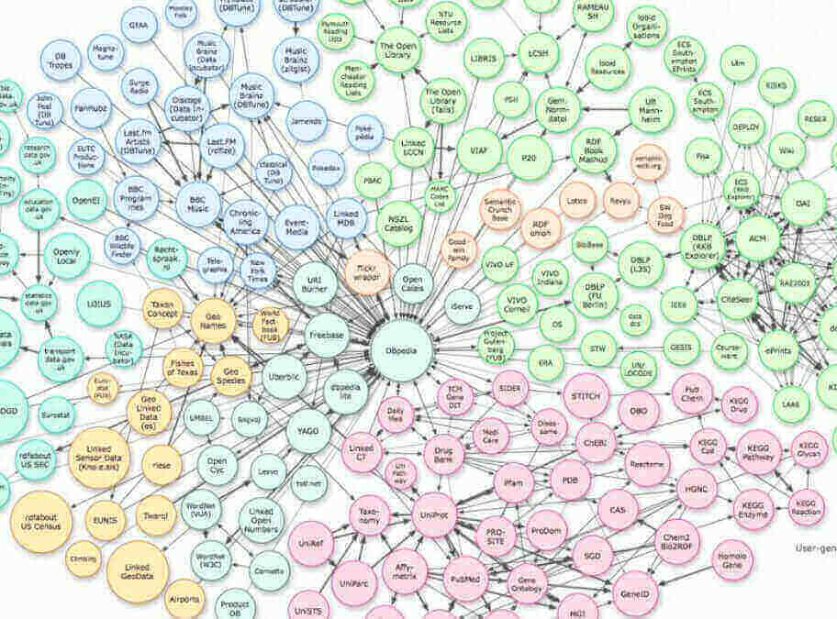
Introduction
Knowledge Graphs
What are knowledge graphs and how can you represent them?

Slide 4
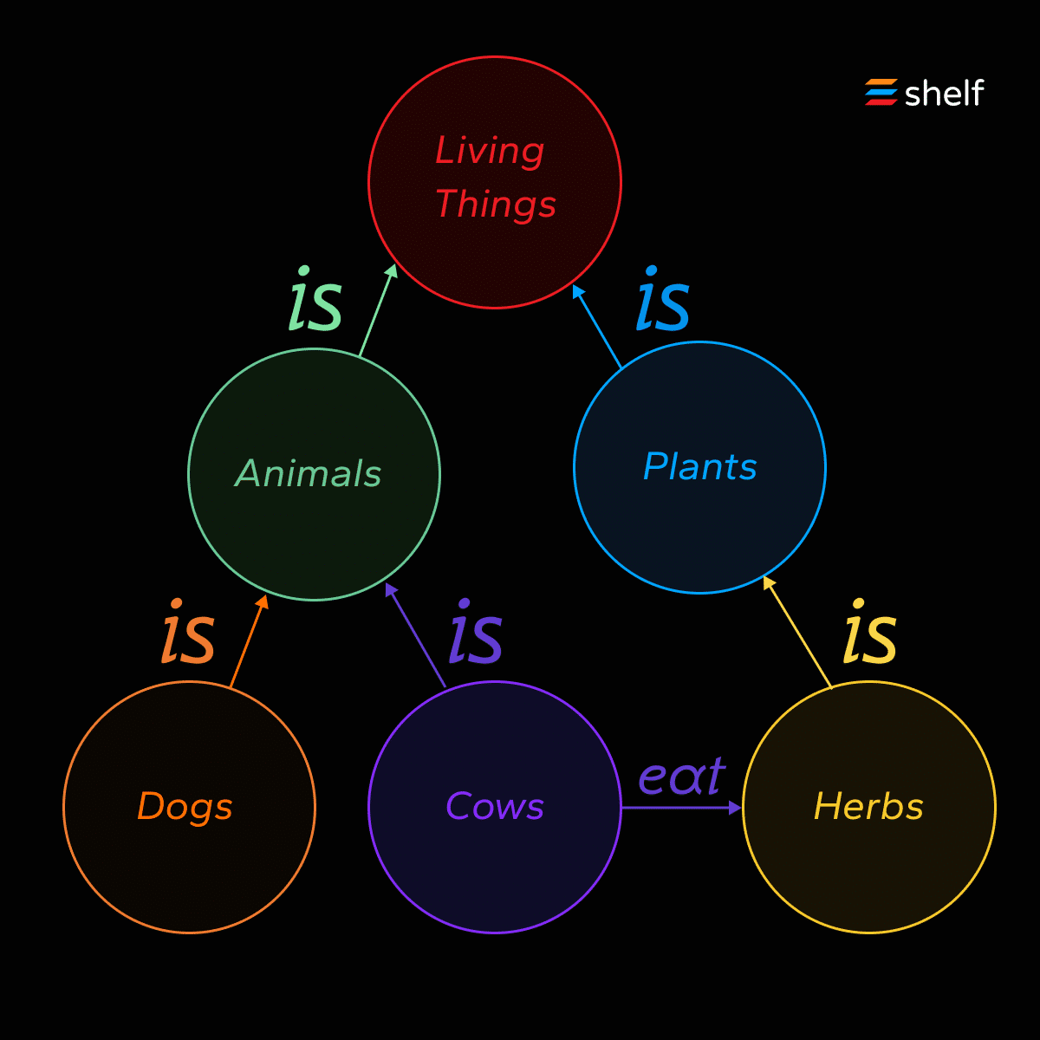
Introduction
Knowledge Graphs
What are knowledge graphs and how can you represent them?

Slide 5
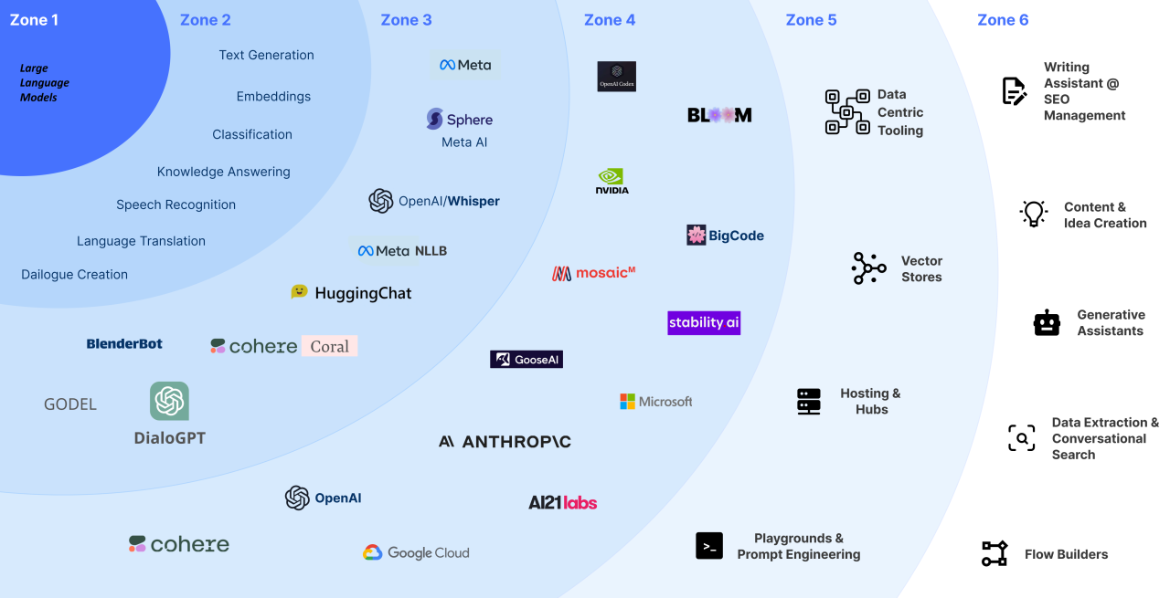
Introduction
Large Language Model
What are LLM’s and why are they important for us ?

Slide 6
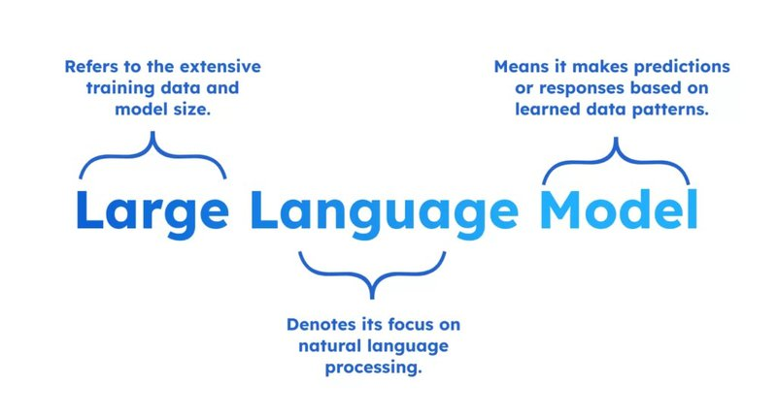
Introduction
Large Language Model
What are LLM’s and why are they important for us ?

Slide 7
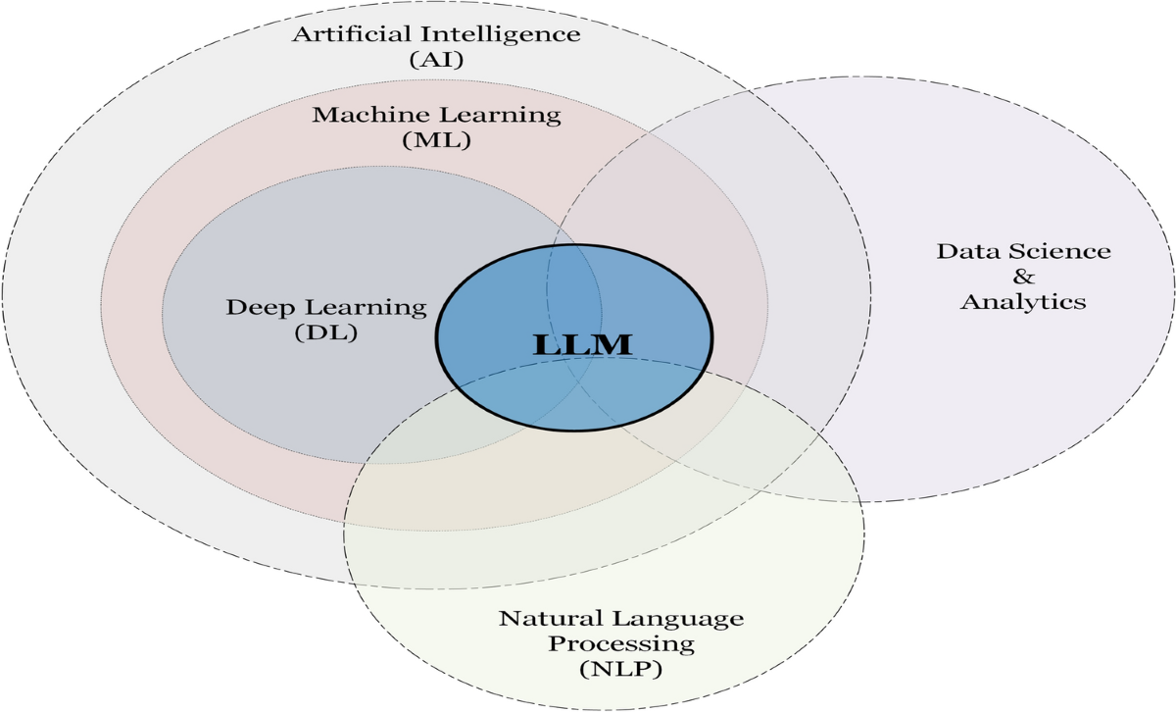
Introduction
Large Language Model
What are LLM’s and why are they important for us ?

Slide 8
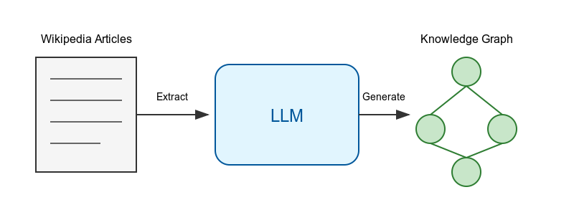
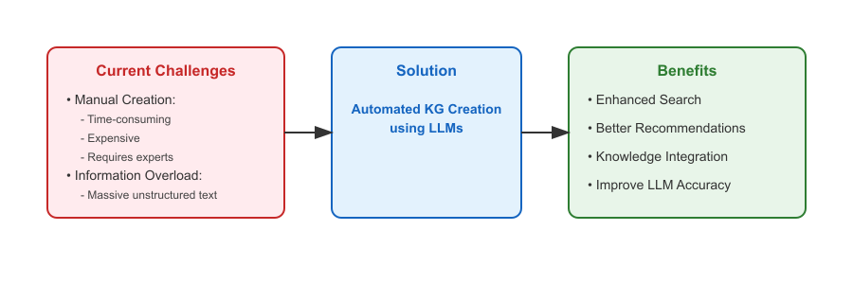
Problem statement
Transform unstructured Wikipedia articles into structured knowledge graphs using LLM’s
Key Components :
Input
Process
Output
Main Challenges :
Accuracy of Triple Extraction
Prompt Design for LLM’s
Ontology Alignment

Slide 9
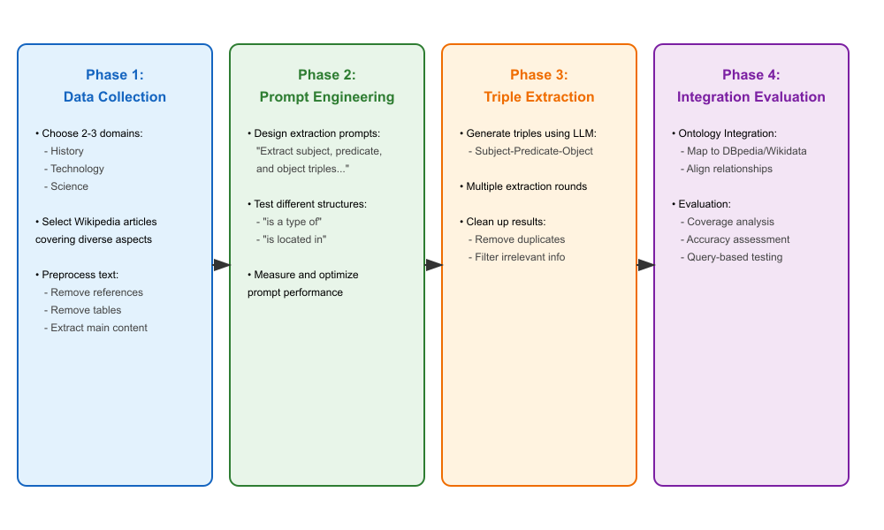
Approach
Our Roadmap :

Slide 10
Thank you for your attention :)
Questions?

Slide 11
Sources
Slide number 5 - Link
Slide number 6 - Link
Slide number 7 - Link
Slide number 8, 9 - Created using a LLM
Slide number 3 - Link
Slide number 4 - Link

